Slide 1


Health insurance

Slide 2
Health Care in Belgium
Belgium offers a public health care system of high-quality.
Free choice of doctor, hospital, pharmacy, etc.
Partial reimbursement of health care expenses
    Doctor
    Medecines
    Hospital
  Reimbursements are based on the national tariffs given by the National Institute for Sickness and Invalidity Insurance (INAMI/RIZIV).

Slide 3
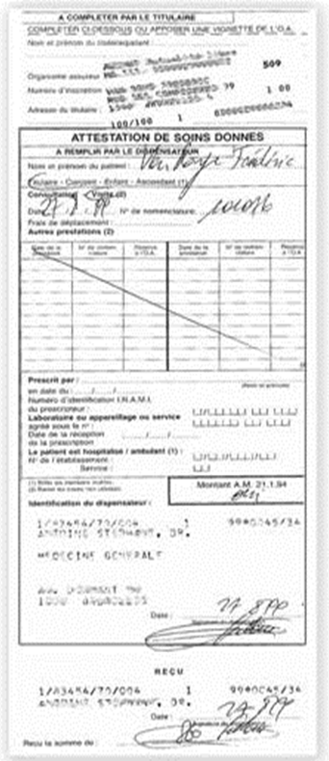
Reimbursement system
Pay full amount
Receive a medical attestation
Affix your Identification sticker on top of it
Drop them off in a mailbox of our agency OR send them by post at the address below:
“ Boulevard Louis Mettewie laan 74/76 - 1080 Bruxelles/Brussel ”
Reimbursement onto your bank account
You have 2 years to send us the medical attestation

Slide 4

Reimbursement system: with E-attest
E-ATTEST*
CASE A | CASE B
Pay full amount | Pay remainder fee
Receive a receipt | Receive a receipt
Reimbursement onto your bank account
* Automatic payment between doctor and health insurance

Slide 5
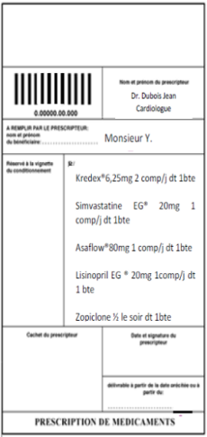
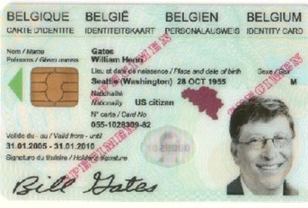
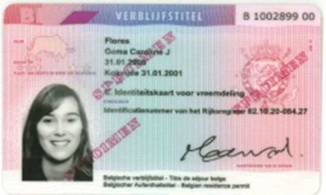
Reimbursement system : Pharmacy
With ID CARD
Medicine
Thanks to your Belgian residence permit, you will only pay the remainder fee at the pharmacy.

Slide 6
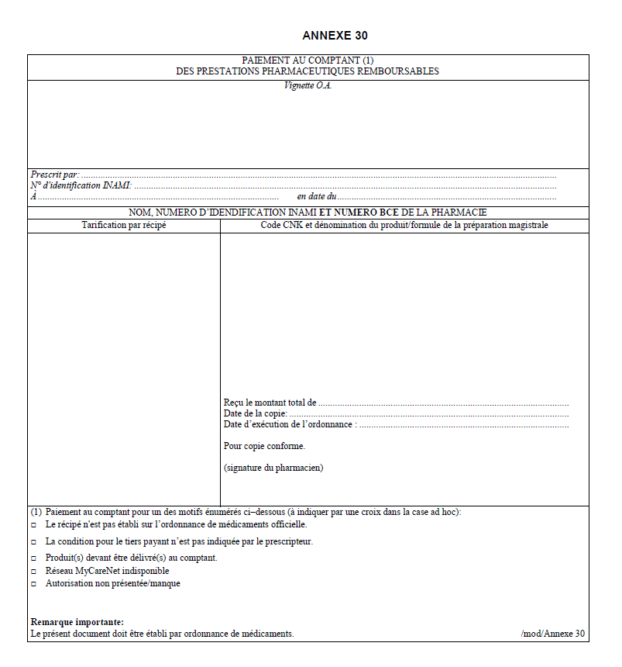
Reimbursement system : Pharmacy
Without ID
Pay full amount
Receive the annex 30
Affix your Identification sticker on top of it
Drop them off in the mailbox of our agency OR send them by post at the address below:
  “ Boulevard Louis Mettewie laan 74/76 -1080 Bruxelles/Brussel ”
Reimbursement onto your bank account
You have 2 years to send us the medical attestation

Slide 7
Reimbursement system : Hospital
Identify yourself (Reception - Terminal desk - Private insurance card )
Contribution of the National health insurance is deducted directly from the hospital bill
Bill sent after a few weeks with remainder fee
  Remainder fee and/or supplements (amount to be paid by yourself) depend on your private hospitalization insurance.
  Costs considerably higher if single room, choice of hospital, medical providers,….

Slide 8
Partenamut : Online tools
Become a WEB member
www.partenamut.be | APP
To order document: id stickers, address change, advantages To calculate your reimbursement To search for general information: rates, doctors, hospital… To check your file

Slide 9
Contact us
To become a member
students@healthinsurance.be
  + Name of your school/university in
  subject
If questions once a member
Via our contact form on
www.partenamut.be
02 444 47 00

