Slide 1
Infosession exchange
Faculty of psychology and educational sciences
Prof. Chang Zhu
Prof. Martijn Van Heel
Drs. Marta Lucchetti
Drs. Ana Laura Escalona Diaz

Slide 2
Topics
Why go on exchange?
A word of warning
Sources of information
Eligibility criteria
Destinations
Learning agreement
FAQ

Slide 3
Why go on exchange?
Cross-cultural perspective on psychology, educational sciences, and adult educational sciences
Learn a new language
Be an ambassador for the VUB
Beneficial for your CV
Beneficial if you would like to pursue a career in academia

Slide 4
A word of warning
You will need to do a lot of paperwork / administration
It might be difficult to get timely reactions from exchange coordinators and professors at the destination
You may face a great deal of uncertainty
It may be difficult to set up a learning agreement that perfectly matches your VUB program
You will need to be flexible
You will need to take responsibility
It is possible that you do not obtain a grant
By default, exchanges for studies are for 1 semester

Slide 5
Sources of information
Exchange coordinators
Adult Educational Sciences & Educational Sciences:
  Marta Lucchetti (Marta.Lucchetti@vub.be) - MES
  Ana Laura Escalona Diaz (Ana.Escalona.Diaz@vub.be) - AGOG
  Prof. Chang Zhu (chang.zhu@vub.be)
Psychology: Prof. Martijn Van Heel (martijn.van.heel@vub.be)
General email address: pe.mobility@vub.be (Freya De Vroede)
VUB website: https://www.vub.be/nl/studeren-aan-de-vub/alle-opleidingen/persoonlijke-ontwikkeling-tijdens-je-opleiding/studeren-in-het-buitenland/eu-uitwisselingen-en-erasmus-bestemmingen-als-vub-student#paragraph-85013

Slide 6
Sources of information
Who do I contact for what?
Exchange coordinators:
  Questions about destinations for exchanges
  Selection and nomination procedure for studies and internships abroad
  Creating and changing learning agreements
International Relations Office (exchange.outgoing@vub.be):
  Questions about grants and scholarships
  Practical questions on studying abroad (e.g., housing)
  Administrative issues
Internship coordinators:
  Internships abroad

Slide 7
Eligibility criteria
Study exchange
For study exchanges of BA students, the conditions to go on exchange:
    You need to have passed your courses of Bachelor year 1.
Students in a bridging or preparatory programme can also apply (the previous rule does not apply for them)

Slide 8
Eligibility criteria
For internships
The same criteria apply as for regular internships (check with your internship coordinator, conditions before you can do your internship)

Slide 9
Destinations
Some destinations are available for BA or MA students only, others for both
Warning: it is often easier for psychology students to go abroad in 3rd Bachelor
Erasmus+ (Europe) - Psychology
Humboldt-Universität zu Berlin | Germany
Université Paris Nanterre | France
Universitat Autonoma de Barcelona | Spain
Universitat de Barcelona | Spain
Ëotvös Lorand University | Hungary
Università degli Studi di Firenze | Italy
Oslo New University College | Norway
Maastricht University | Netherlands
Tilburg University | Netherlands
Universidade de Coimbra | Portugal
Universitatea Babes-Bolyai | Romania
University of Gothenburg | Sweden
University of Ljubljana | Slovenia
Marmara University | Turkey
Istanbul Bilgi University | Turkey
University of Warwick | United Kingdom

Slide 10
Destinations
EUTOPIA PARTNERS - Psychology
Partner Eutopia | Study field | Spots | Remark
University of Gothenborg (Sweden) | Psychology | 14 university wide spots at MA level | Difficult course match for Psychology students
Universitatae Babes-Bolyai (Romainia) | Psychology | 2 x BA 2 x MA
University of Ljubljana (Slovenia) | Psychology | 2 x BA 2 x MA
Univ of Warwick (UK) | Psychology | 2 x BA | full year only= 10m

Slide 11
Destinations
Erasmus+ (Europe) - Psychology
Eotvas Lorand University (Budapest, Hungary)
  Available places for Bachelor/Master students: 2
  Language courses: English
  Language requirements: B1
Humboldt-Universitat zu Berlin (Berlin, Germany)
  Available places for Bachelor/Master students: 2
  Language courses: German
  Language requirements: C1
  Extra fee of 265.64€ needs to be paid by exchange students themselves
  Be aware that fall semester at Humboldt university ends mid-February (with exams at end of February)

Slide 12
Destinations
Erasmus+ (Europe) - Psychology
Universitat de Barcelona (Barcelona, Spain)
  Available places for Bachelor/Master students: 2
  Language courses: Catalan, Spanish, English
  Language requirements: B1
Universitat Autonoma de Barcelona (Bellaterra, Barcelona, Spain)
  Available places for Bachelor/Master students: 4
  Language courses: Catalan, Spanish, English
  Language requirements: B1

Slide 13
Destinations
Erasmus+ (Europe) - Psychology
University degli studi di Firenze (Florence, Italy)
  Available places for Bachelor students: 2
  Available places for Master students: 2
  Language courses: Italian
  Language requirements: B1
Université Paris Nanterre (Nanterre, France)
  Available places for Bachelor & Master students: 4
  Language courses: French
  Language requirements: B1 (certification required)
  Remark: high level! 2nd semester starts on the 17th of January, so VUB exams taking place in that period may need to be rescheduled (request via dean)

Slide 14
Destinations
Erasmus+ (Europe) - Psychology
Maastricht University (Maastricht, the Netherlands)
  Available places for Bachelor students: 4
  Language courses: English
  Language requirements: B2
Tilburg University (Tilburg, the Netherlands)
  Available places for Bachelor students: 3
  Language courses: English, Dutch
  Language requirements: B2

Slide 15
Destinations
Erasmus+ (Europe) - Psychology
Universidade de Coimbra (Coimbra, Portugal)
  Available places for Master students: 4
  Language courses: Portuguese, English
  Language requirements: A2-B2
Oslo New University College (Oslo, Norway)
  Available places for Bachelor students: 2
  Language courses: English
  Language requirements: B2

Slide 16
Destinations
Erasmus+ (Europe) - Psychology
Istanbul Bigli University (Istanbul, Turkey)
  Available places for Bachelor students: 5
  Language courses: English
  Language requirements: B2
Marmara University (Istanbul, Turkey)
  Available places for Bachelor students: 2
  Language courses: English
  Language requirements: B2

Slide 17
Destinations
Erasmus+ (Europe) - Psychology
EUTOPIA partners:
  University of Gothenborg (Sweden): 14 university wide spots (Master level; for 1 semester)
  University of Ljubljana (Slovenia): 2 Bachelor and 2 Master level spots (for 1 semester)
  University of Warwick (England, UK): 2 Bachelor level spots (full year only = 10M)
    2 ECTS at Warwick = 1 ECTS at VUB
  Universitatea Babes-Bolyai (Romania): 2 Bachelor and 2 Master level spots (for 1 semester)
Notes:
Gothenburg

Slide 18
Destinations
Erasmus+ (Europe) – educational sciences & Adult Educational sciences
Technische Universitaet Dresden | Germany
Universitat de Barcelona | Spain
Universitat Autonoma de Barcelona | Spain
Tallinn University | Estonia
Université Paris Nanterre | France
Università degli Studi del Molise | Italy
Universita degli Studi di Firenze | Italy
Ca'Foscari University of Venice | Italy
Universitatea Babes-Bolyai | Romania
University of Gothenburg | Sweden
Stockholm University | Sweden
Tampere University | Finland
University of Ljubljana | Slovenia
Middle East Technical University | Turkey
Istanbul Bilgi University | Turkey

Slide 19
Destinations
Erasmus+ (Europe) – educational sciences & Adult Educational sciences
Universitat de Barcelona (Barcelona, Spain)
  Available places for Bachelor/Master students: 2
  Language courses: Catalan, Spanish, English
  Language requirements: B1
Universitat Autonoma de Barcelona (Barcelona, Spain)
  Available places for Bachelor students: 2
  Available places for Master students: 1
  Language courses: Catalan, Spanish, English
  Language requirements: B1

Slide 20
Destinations
Erasmus+ (Europe) – educational sciences & Adult Educational sciences
Tallinn University (Tallinn, Estonia)
  Available places for Bachelor/Master students: 3
  Language courses: English, Estonian
  Language requirements: B2
Université Paris Nanterre (Nanterre, France)
  Available places for Bachelor & Master students: 4
  Language courses: French
  Language requirements: B1 (certication required)
  Remark: high level! 2nd semester starts on the 17th of january, so VUB exams taking place inthatperiod may need to be rescheduled (request via dean)

Slide 21
Destinations
ERASMUS+ (EUROPE) – educational sciences & Adult Educational sciences
Tampere University (Tampere, Finland)
  Available places for Bachelor students: 2
  Available places for Master students: 2
  Language courses: English
Stockholm University (Stockholm, Sweden)
  Available places for Master students: 2
  Language courses: English
  Language requirements: B1

Slide 22
Destinations
Erasmus+ (Europe) – educational sciences & Adult Educational sciences
Università degli Studi del Molise (Campobasso, Italy)
  Available places for Master students: 4
  Language courses: Italian
  Language requirements: B1
Universita degli Studi di Firenze (Florence, Italy)
  Available places for Bachelor students: 2
  Language courses: Italian
  Language requirements: B1
Ca'Foscari University of Venice (Venice, Italy)
  Available places for Bachelor students: 2
  Available places for Master students: 2
  Language courses: Italian
  Language requirements: B1

Slide 23
Destinations
ERASMUS+ (EUROPE) – educational sciences & Adult Educational sciences
Middle East Technical University (Ankara, Turkey)
  Available places for Bachelor students: 3
  Available places for Master students: 2
  Language courses: English
  Language requirements: B2
Istanbul Bilgi University (Istanbul, Turkey)
  Available places for Bachelor students: 3
  Language courses: English
  Language requirements: B2

Slide 24
Destinations
ERASMUS+ (EUROPE) – educational sciences & Adult Educational sciences
EUTOPIA partners:
  TU Dresden (Dresden University of Technology, Germany): 2 spots for Master students (for 1 semester)
  University of Gothenborg (Sweden): 14 university wide spots (Bachelor + Master; for 1 semester)
  University of Ljubljana (Slovenia) : 2 spots for Bachelor students and 2 spots for master students (for 1 semester)
  Universitatea Babes-Bolyai (Romania): 2 spots for Bachelor students and 2 spots for master students (for 1 semester)
  Ca'Foscari University of Venice (Venice, Italy)

Slide 25
Destinations
EUTOPIA PARTNERS
Partner Eutopia | Studyfield | Spots | Cycle | Remark
TU DRESDEN | (Adult) Educational Sciences | 2 x 5 months | 2nd
University of Gothenborg | (Adult) Educational Sciences | 14 university wide spots | 1st, 2nd
University of Ljubljana | (Adult) Educational Sciences | 2 x 5 months | 1st
 | (Adult) Educational Sciences | 2 x 5 months | 2nd
Universitatea Babes-Bolyai | (Adult) Educational Sciences | 2 x 5 months | 1st
 | (Adult) Educational Sciences | 2 x 5 months | 2nd

Slide 26
Destinations
Outside of europe
Available destinations: see list IRMO presentation non-EU destinations
    Psychology: 9 countries (12 Universities)
    (Adult) Educational Sciences: 8 countries (20 Universities)
Differences with EU-destinations:
  More competition for grants
  No official limit on places available per destination
  Application procedure is more complicated
  Host institution may apply their own selection procedures as well

Slide 27
Destinations
Inside Belgium
Possibility for exchange with Université Libre de Bruxelles
  For all PE students
  Non-mandatory courses (elective courses)
  https://www.vub.be/nl/studeren-aan-de-vub/praktische-info-voor-studenten/studentenadministratie/keuzevakken-en-formulieren
  https://www.ulb-vub.be/nl/faq-uitwisseling-vakken-en-modules

Slide 28
Learning agreement
What is a Learning agreement (LA)?
Official document listing the courses you will take at your host university, in exchange for VUB courses
You select courses worth 21-30 ECTS (for one semester)
Each selected course in your host university is linked to a VUB course
There needs to be a balance between the total amount of ECTS on both sides of the learning agreement (max. 2 ECTS difference between both sides – see FAQ at end of slides for more information)
In case of an imbalance in ECTS between both sides, the ECTS of VUB counts

Slide 29
Learning agreement
How do I create a LA?
Students are responsible for their own LA
Look at the website of the host institution for information on available courses
Contact the exchange coordinator at the host institution
You will create an LA before going to the host institution, but keep in mind that you can (and likely will) make changes to you LA during the first weeks of your mobility

Slide 30
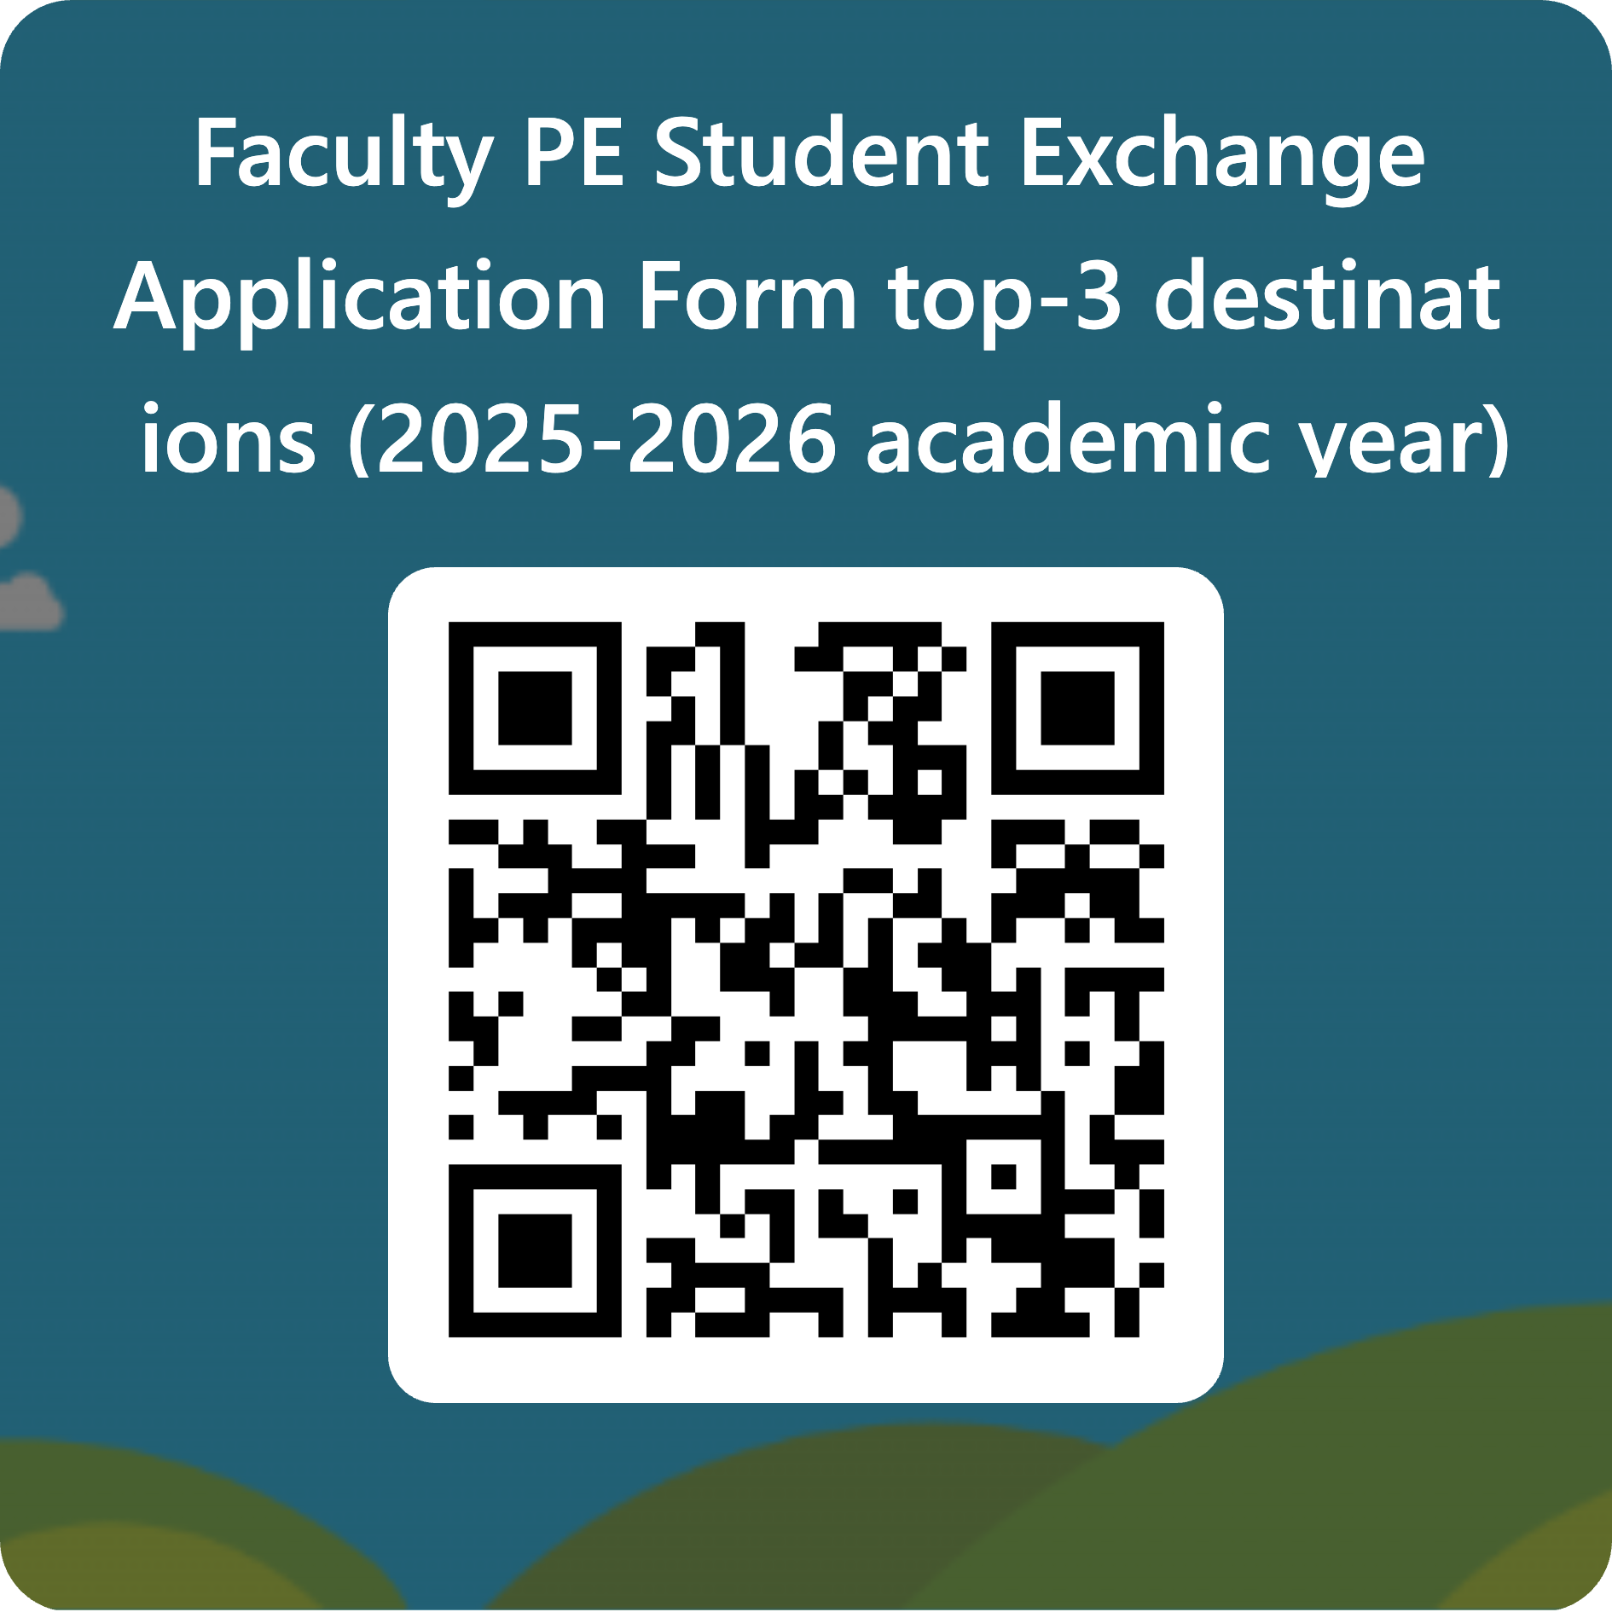
Learning agreement
Application procedure
STEP 1: Submit a top-3 of destinations + motivation letter
  Deadline: Friday 5 December 2025
  Submission form: https://forms.office.com/e/5EihUfY494
Selection procedure:
  Exchange coordinators select students for destinations (students who select a non-EU destination will be nominated early to IRMO to speed up process)
  Criteria: motivation letter + grades (if available) + status student (student with/without fewer opportunities) + participation in mobility in past years
  All applicants are ranked based on criteria, and allocated to destinations
  You will receive an email from your exchange coordinator in December/January
Notes:
By fewer opportunities we mean :
- Scholarship students
- Almost scholarship students
- Working students**
- Students with disabilities recognized by VAPH

Slide 31
Learning agreement
Application procedure
STEP 2: Send a first proposal of your LA to your exchange coordinator
  Deadline: Monday 2 February 2026
  Use the template “Document voorstel Learning Agreement”
  Add course description of selected courses (in English)
  You will receive feedback from your exchange coordinator

Slide 32
Learning agreement
Application procedure
STEP 3: Send a revised learning agreement to your exchange coordinator
  Deadline: Monday 2 March 2026
  Exchange coordinator will decide if your revised LA can be approved
  If your LA is approved, the exchange coordinator will officially nominate you for an exchange with IRMO
  IRMO will contact you, to guide you through the rest of the application procedure, including to apply on 'Mobility Online' and upload all related documents

Slide 33
internship
Application procedure FOR Internships
STEP 1: Contact your internship coordinator
  You can suggest a destination of your own choosing
  Get approval from internship coordinator on destination and internship plan
STEP 2: Contact your exchange coordinator
  Outside EU: deadline: Friday 5 Dec. 2025
  Within EU: deadline: Monday 2 March 2026
  Inform exchange coordinator of destination, so we can nominate you with IRMO

Slide 34
Study + Internship exchange manual
For Educational Sciences and Adult educational sciences
Exchange manual available (in English and in Dutch) on the Canvas community (MES and AGOG) to help you in the process of applying/preparing for an exchange.
Manual Exchange EDWE EN.pdf
Manual Exchange EDWE NL.pdf
Please contact: marta.lucchetti@vub.be (MES)
Ana.Escalona.Diaz@vub.be (AGOG) for further questions

Slide 35
FAQ
My LA is already officially approved, but I want to make changes. What do I need to do?
  Contact your exchange coordinator. Send a proposal for a changed LA using the template “Document voorstel Learning Agreement”. You can enter changes in mobility online during first week of exchange.
I changed my mind and I want to stop my exchange
  Inform your exchange coordinator, IRMO, and the host institution
Do I need to register the VUB courses in my LA in self-service?
  No, the faculty administration will do this for you
Can I select a language course in my LA?
  Yes, in exchange for a VUB keuzevak and provided that the language course is taught at the host institution

Slide 36
FAQ
I must redo exams at the VUB in August-September, can I still go on exchange?
  You will have to wait until the official proclamation of the exams in the beginning of September before you can leave on exchange. You will be allowed to go on exchange if you meet the eligibility criteria and if you did not get an “Inschrijving niet toegelaten” following the exams
I failed an exam at the host institution, what now?
  Try and redo the exam at the host institution. If this is not possible, redo the VUB course in the second exam period. If this does not happen, redo the VUB course next academic year.
I exchanged 2 courses at the host institution for 1 VUB course, but I failed 1 of the 2 courses at the host institution. What now?
  Try and redo the exam at the host institution. If this is not possible, redo the VUB course in the second exam period. If this does not happen, redo the VUB course next academic year.
I want to leave in the first week of February, but I still have an exam at the VUB.
  You can ask the dean of the faculty to allow you to do the exam on a different day (see Onderwijs- en examenreglement)

Slide 37
FAQ
Are differences in ECTS allowed between VUB courses and courses at the host institution in the learning agreement?
  Yes, differences are allowed. However, we do check the difference between the total amount of ECTS for VUB courses in the LA and the total amount of ECTS for host institution courses. This difference should not be larger than 2 ECTS. The exception to this is that students can take more credits at the host institution, but these extra credits will not be recognized at the VUB then. For example:
    19 ECTS at VUB – 21 ECTS at host institution = ok
    21 ECTS at VUB – 19 ECTS at host institution.= ok
    21 ECTS at VUB – 18 ECTS at host institution = not ok
    18 ECTS at VUB – 21 ECTS at host institution = ok

Slide 38

Student Testimonial
Bente Vanhuffel

